Slide 1
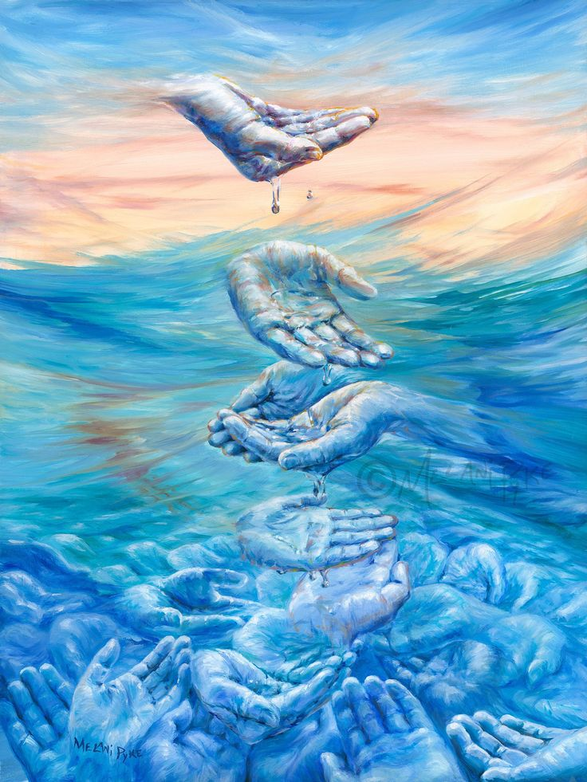

Rotary Young Artist/ Photograpy Competition 2025
Wonderful Water Theme
Deadline 31st January

Slide 2

LEARNING INTENTION
SUCCESS CRITERIA
I have learned to motivate myself to create an expressive composition based on personal choice
You are successful if you have created an original art work with a clear link to the theme of ‘wonderful water’
Starter Task: Think of as many different things as you can that have some connection to water – create a mind map

Slide 3
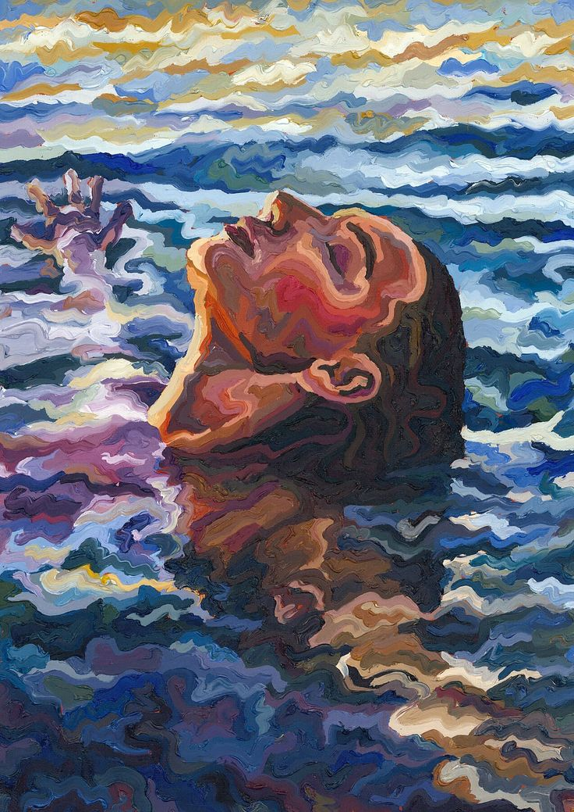
Inspiration Should be ‘Wonderful Water’
Complete a mind map with two others naming everything you can think of that has some connection to water
Use your phone/computer to google the theme ‘wonderful water’ – do a rough sketch of your idea in your sketchbook
On a separate piece of paper, work up your idea.

Slide 4
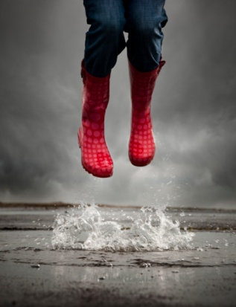
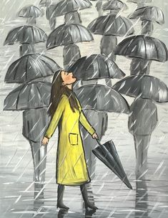
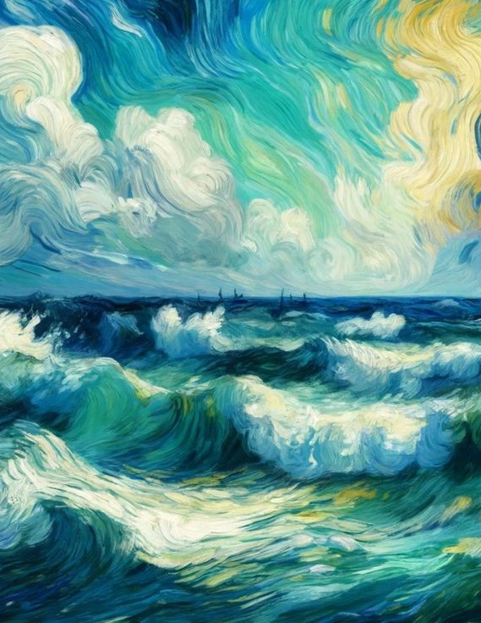
You can get inspiration from photos or paintings

Slide 5
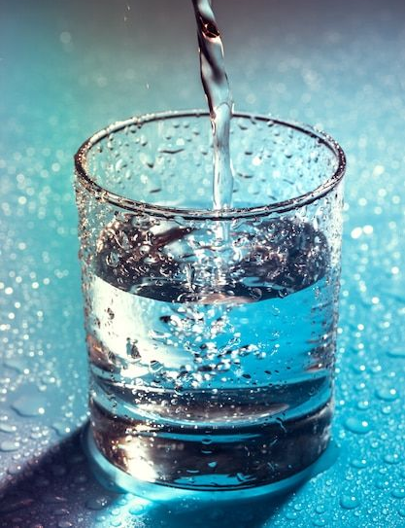
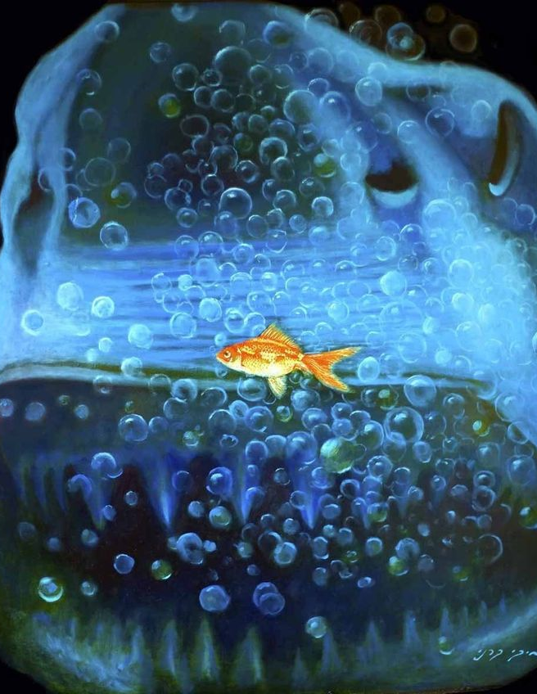
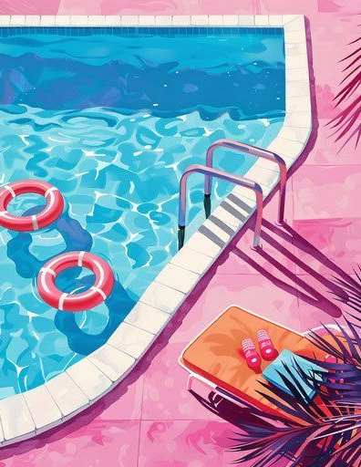
You can create an original composition of your own. You can work in any media - coloured pencils/ paint/ pens/ modelling clay…..etc…

Slide 6
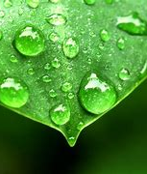
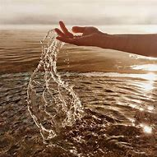
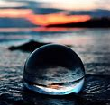
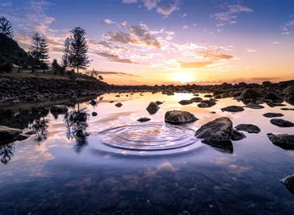
OR experiment with water and get creative with your camera…..

Slide 7
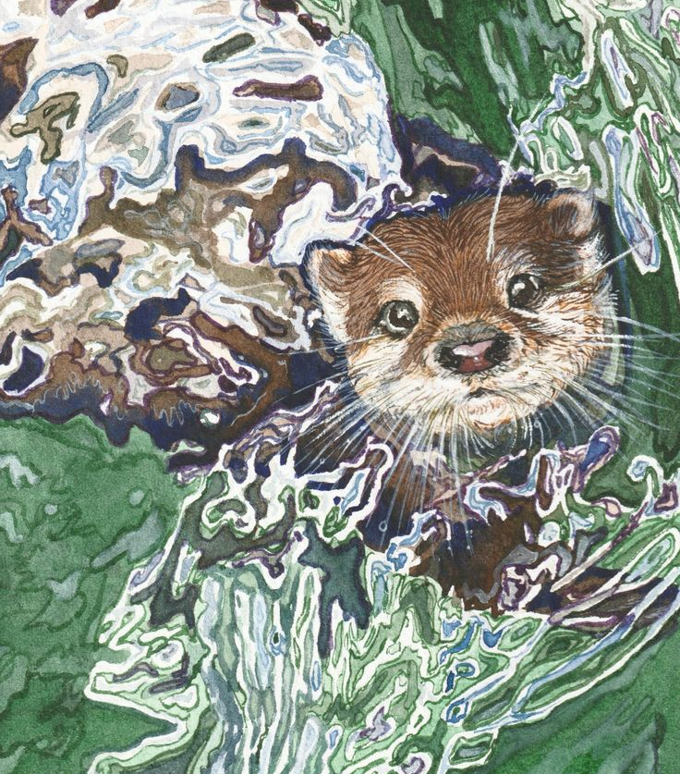
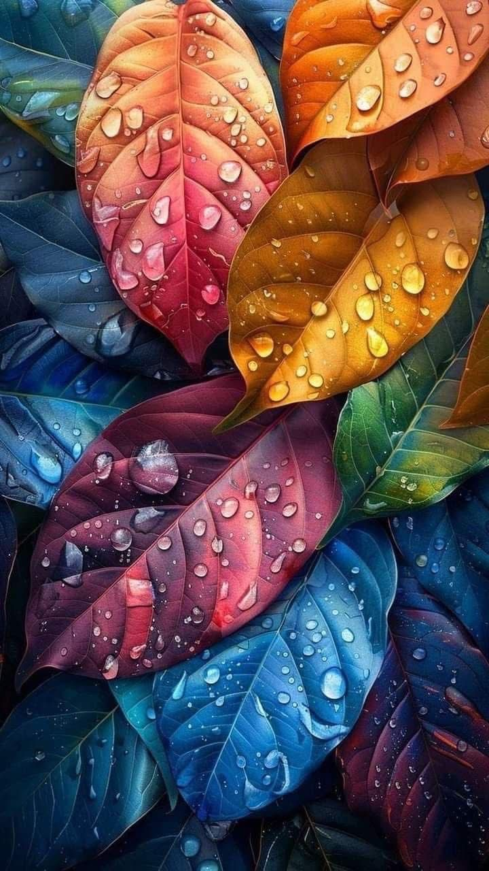
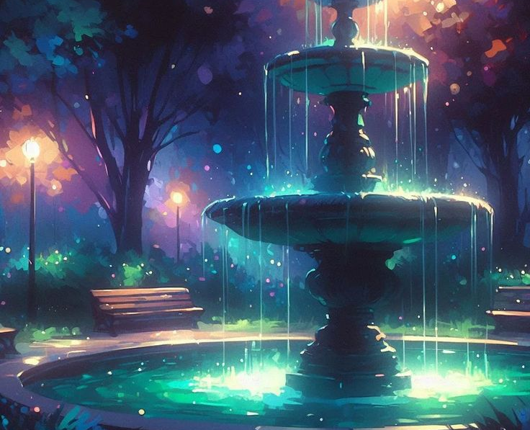
When finished, complete a form.
Parents have all been emailed a digital form or ask Mrs Murch for a paper copy.
Hand in entries to teacher/ office.
Photographs can be emailed to address on form.

